Slide 1
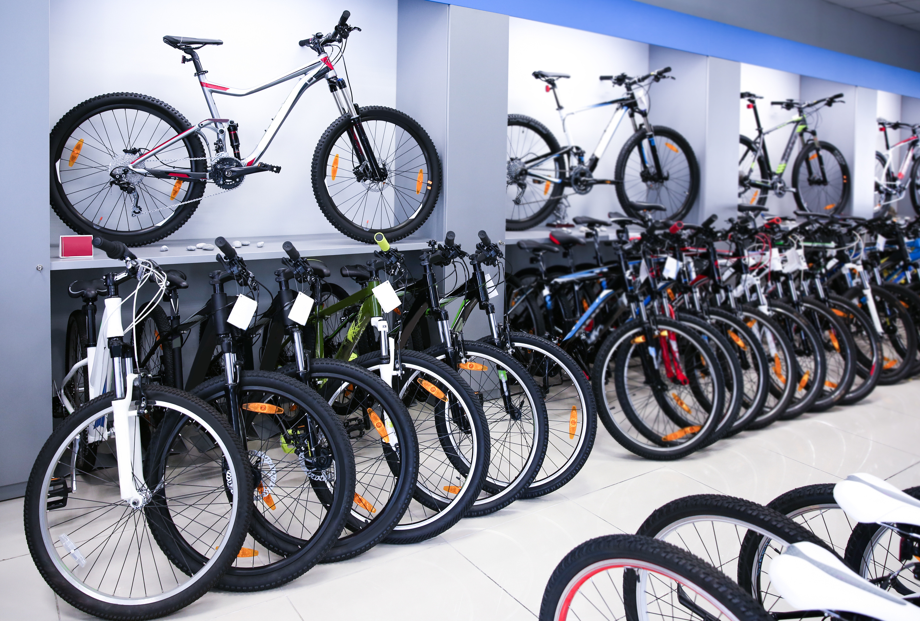


BICYCLE E-COMMERCE SYSTEM
Page 01
Presented By:
 | Name | Adm No
1. | Preston Mayieka | COM/047/21
2. | Shadrack Kimaau | COM/017/21
3. | Vladmir Nyataige | COM/062/21
4. | Lewis Kiprono | COM/032/21
20
22
For COMP 311

Slide 2


Table Of Contents
Problem Statement
Objectives
Features
Demo
Limitations
Benefits of this system
Conclusion
Slide 02

Slide 3
Problem Statement
Selling bikes physically is tough because the customer reach is limited.
The customers have to travel to the sellers place in order to view, inspect and test bikes.
It's hard to find the right bike, and sometimes the stores don't have what buyers want.
For sellers, finding buyers and managing sales records can be a challenge.
This makes buying and selling bikes a difficulty for everyone involved.
Slide 03

Slide 4
2. Objectives
To enhance User Experience - Through User Friendly interfaces, that allow the user easily purchase the bike he/she wants.
To Provide Clear Information about bikes - Each bike has its own page containing, name, price, description, category
To simplify record keeping and retrieval - Through electronic database and report generation
To expand market reach - reach a broader audience
Slide 04

Slide 5
3. Features
Browse and Purchase: Users can easily browse through a wide range of bicycles available on the platform and make purchases with just a few clicks.
User Authentication: User can login / sign up
Order Management: Users can view their order history, track the status of their orders, and admins can manage the orders conveniently.
Dynamic Report Generation – Can generate reports on orders, inventory and users
Slide 05

Slide 6
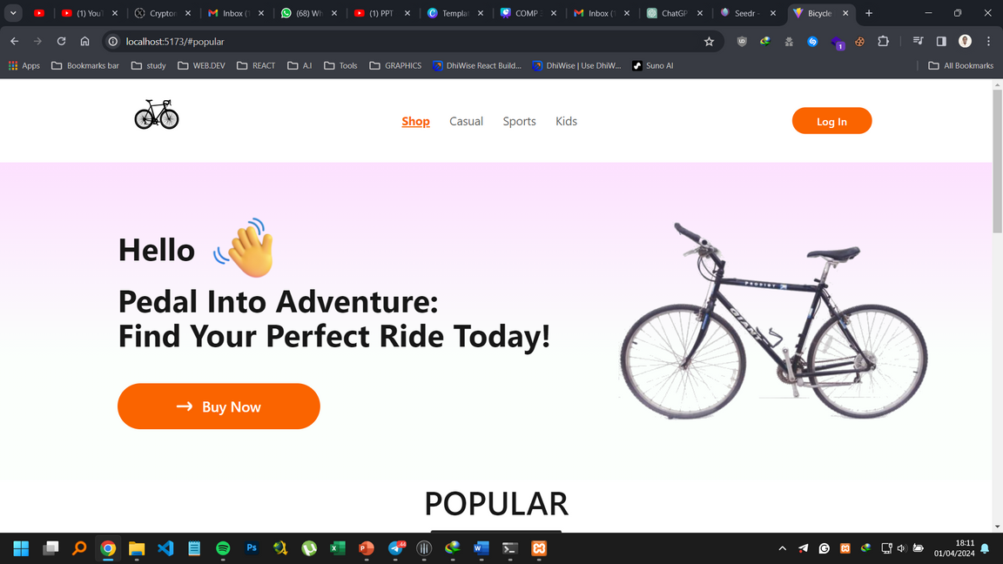
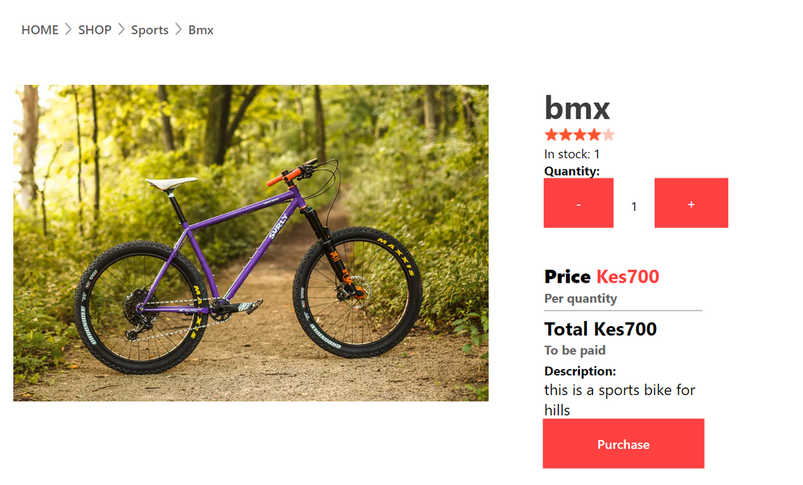


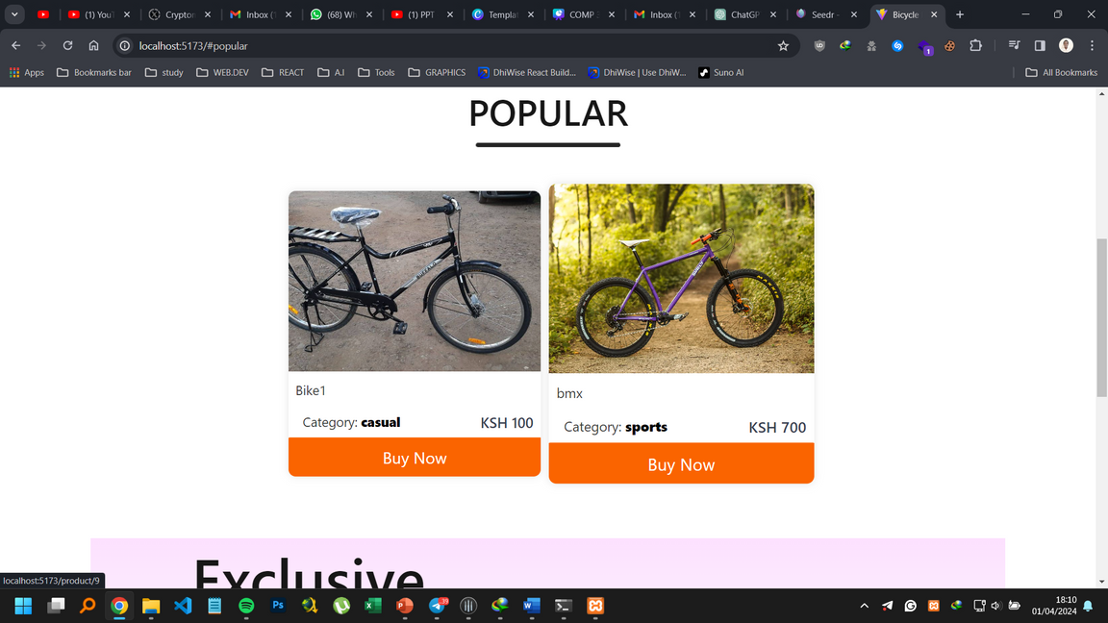
4. How it works
Slide 06

Slide 7
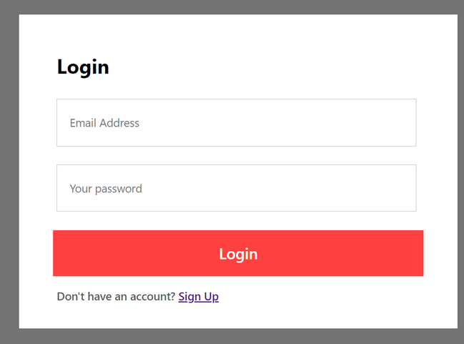
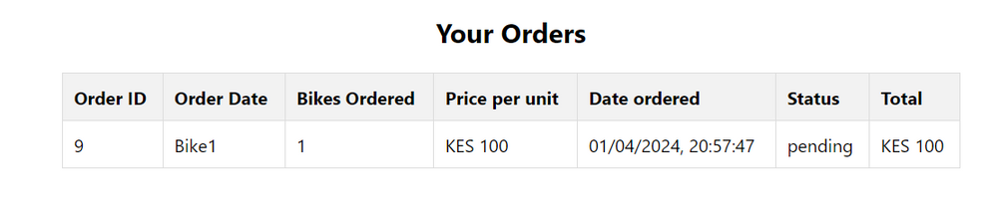
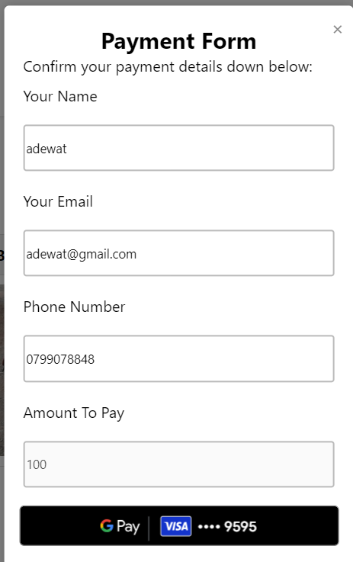

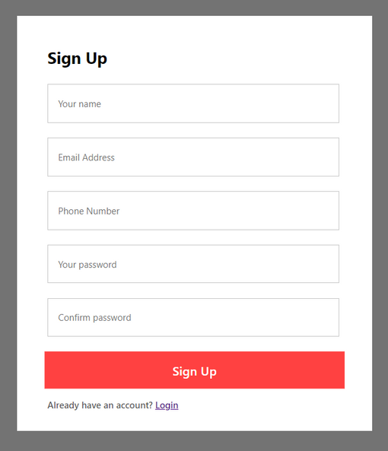

User authentication
Track your order location
Pick Your Bike from the shop
Slide 07

Slide 8
Project Demo

Slide 9
5. Benefits
Increased Sales Opportunities: Customers do not necessarily have to travel to local shops to buy commodities.
Scalable - As records keep on increasing, it will be easier to manage and retrieve them.
Data-driven Decision Making: sales trends help the seller to make decisions that could maximize profit
Detailed Product Information: It provides comprehensive information about bikes such as name, price, category and description
Slide 08

Slide 10
6. Limitations
Security Concerns: The system might be vulnerable to cyber attacks such as payment fraud
Technical Challenges: including hosting, server maintenance, power loss may hinder business operations
Slide 09

Slide 11
Conclusion
In conclusion, the bicycle e-commerce system offers an efficient and user-friendly platform for customers to purchase bicycles online.
With its wide range of products, competitive prices, and secure payment system, customers can shop with confidence and ease.
Furthermore, the system's streamlined order processing.
Overall, the bicycle ecommerce system provides a convenient and reliable solution for anyone looking to purchase bicycles online.
a

